Slide 1
GENERAL CHARACTERS OF PTERIDOPHYTA
BY
Dr. Shraddha Tiwari
Department of Botany

Slide 2
Pteridophyta originated from-
Pteron- feather like
Phyton- plants
They are also known as vascular Cryptogams
According to Parihar- pteridophytes are the most primitive living and fossil vascular plants
According to Masahiro Kato (2005) , a Japanese Pteridologist- free sporing vascular land plants that evolutionarily link bryophytes and seed plants.

Slide 3
Occurrence
1. Most pteridophytes are terrestrial and grow in moist and shady places while some flourish well in open, dry places especially in xeric conditions. Some pteridophytes are aquatic and some are epiphytes.

Slide 4
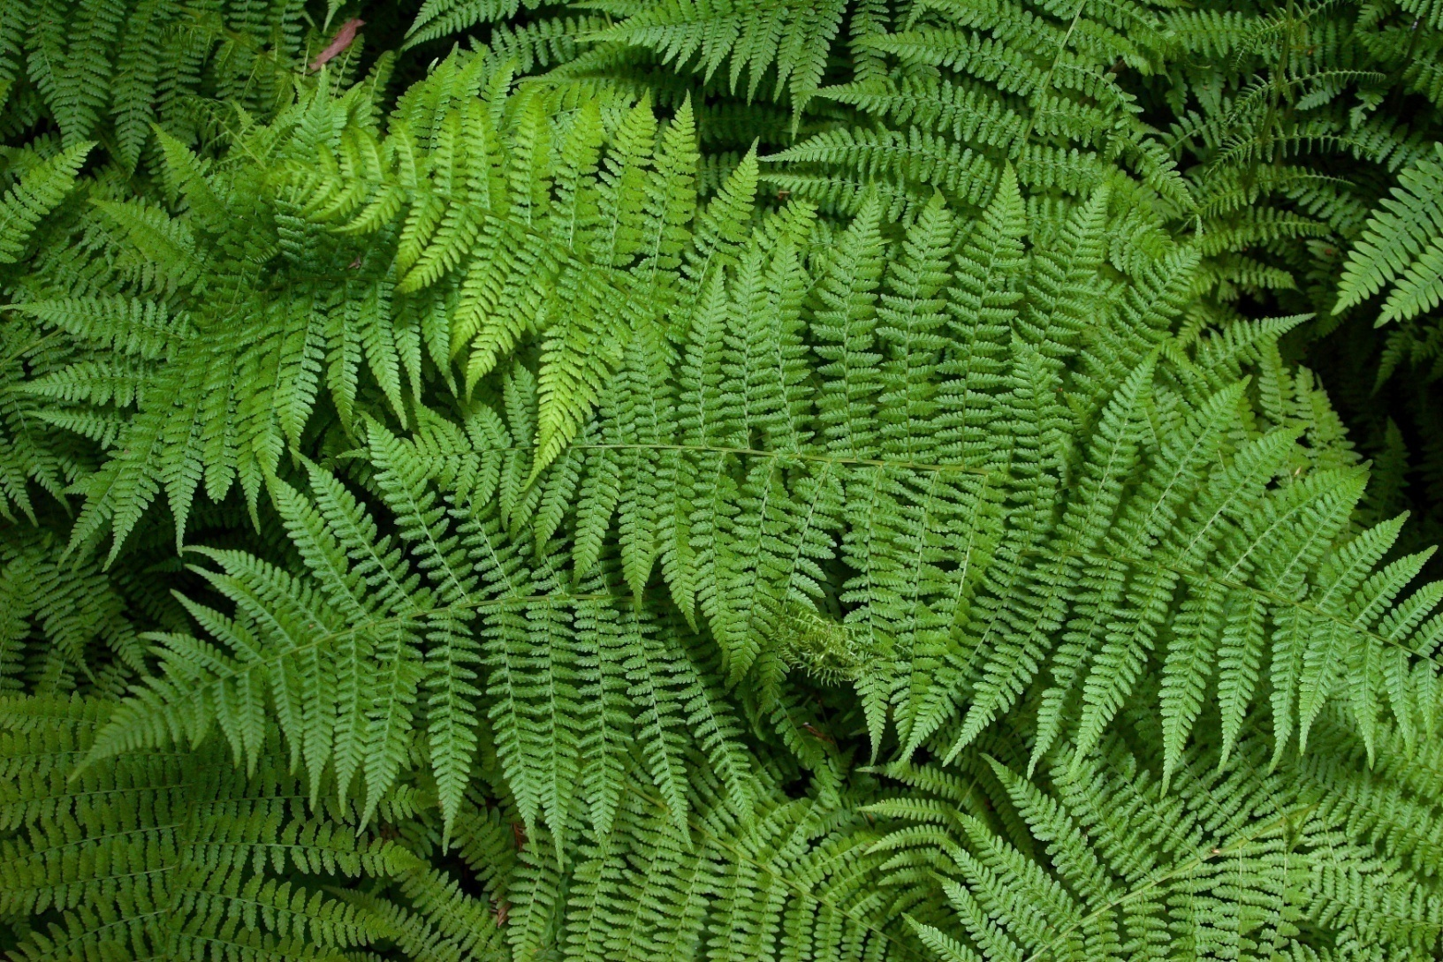
MOIST HABITAT

Slide 5
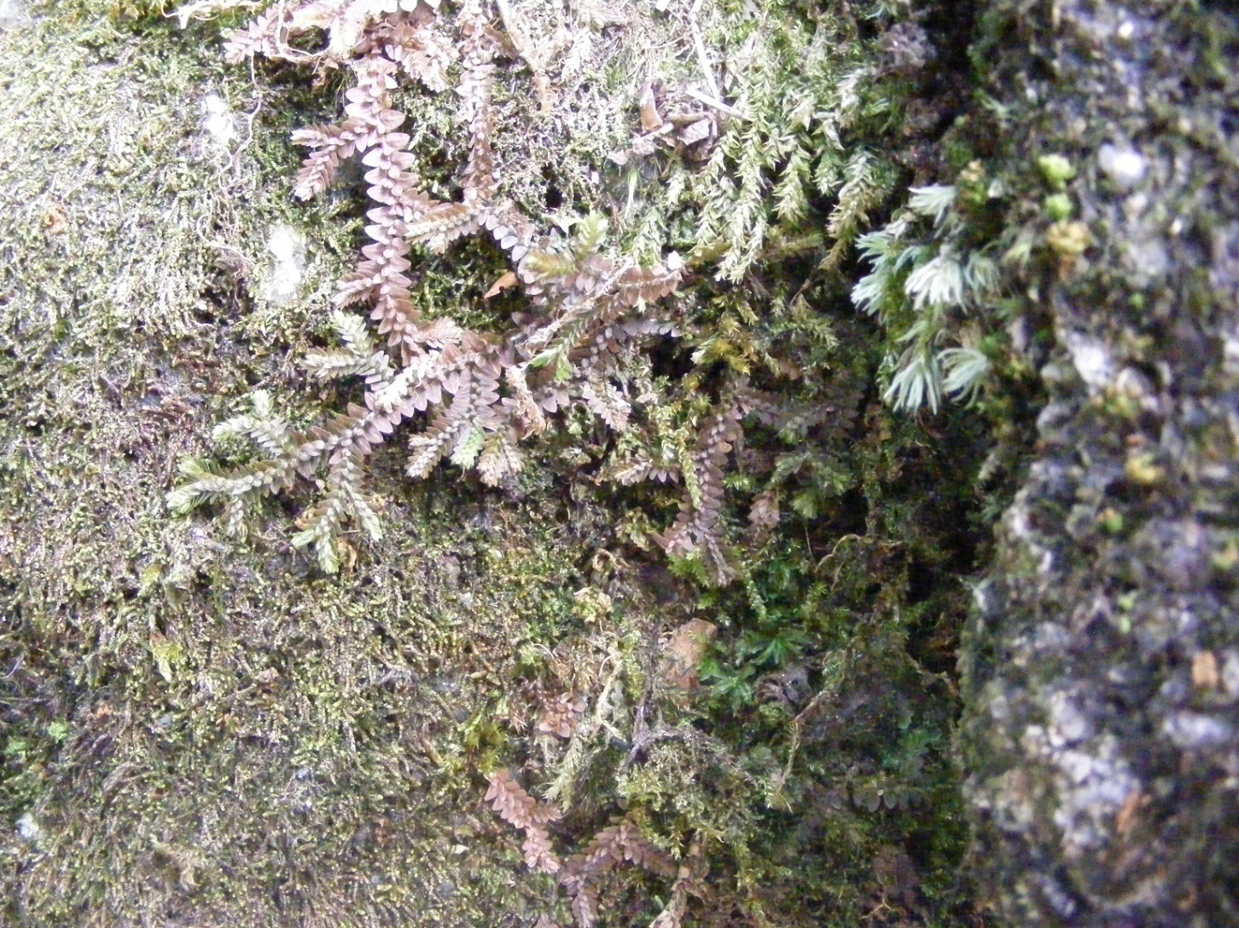
Xeric Condition

Slide 6
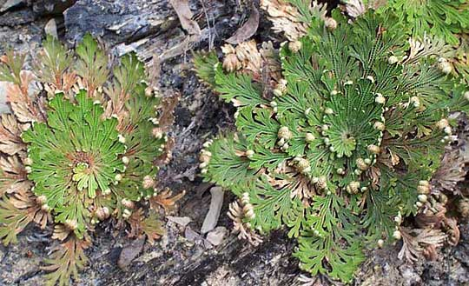
MOIST HABITAT

Slide 7
2. The sporophyte is the conspicuous and familiar plant body. It develops from the zygote, a diploid cell which results from the fertilization of the egg and antherozoid.

Slide 8
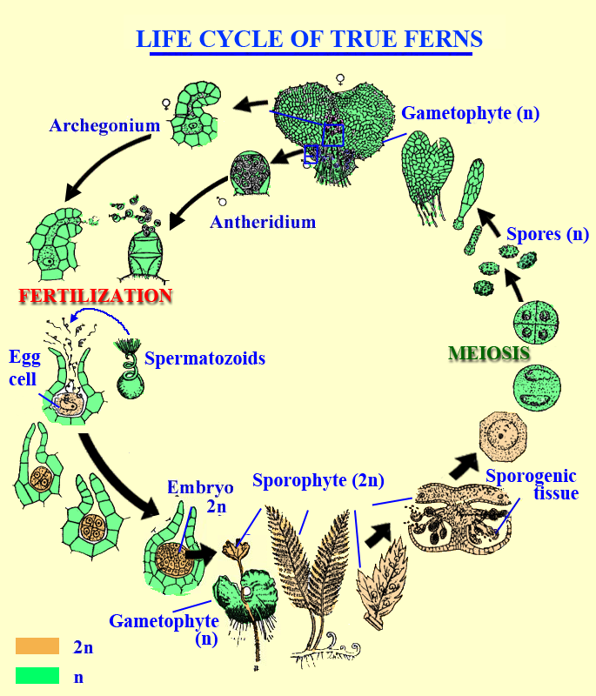

Slide 9
3. The sporophytic plant body remains differentiated into true roots, stem and leaves. Some primitive members lack true roots and well developed leaves (e.g., in Psilophytales and Psilotales).

Slide 10
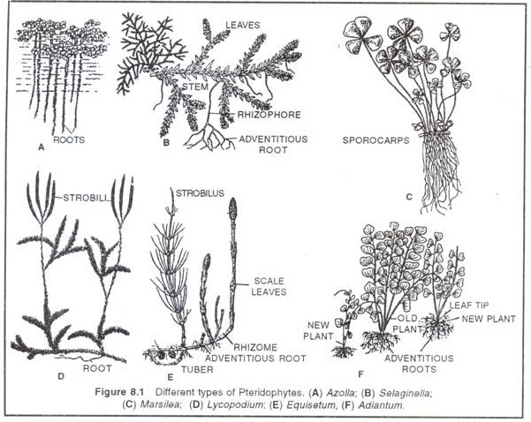

Slide 11
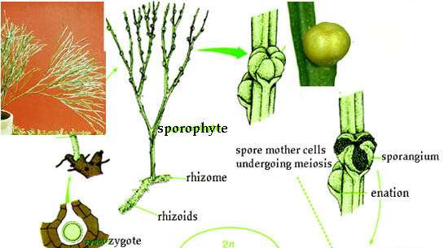
Psilotum

Slide 12
4. The branching of the stem may be of monopodial or dichotomous type.
5. There are two main categories of form and structure, one category comprises of megaphyllous types, in which the leaves are large in relation to the stem (e.g., ferns); the second comprises of microphyllous types in which the leaves are quite small in relation to the stem (e.g., Lycopods and Horse-tails).

Slide 13
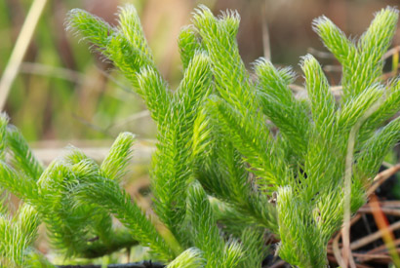
Microphyllous- Lycopodium

Slide 14
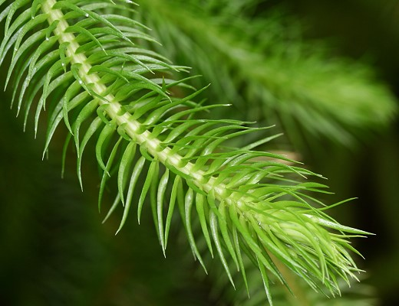
Microphyllous- Lycopodium

Slide 15
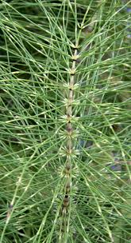
Equisetum

Slide 16
Megaphyllous- Ferns

Slide 17
Leaves -
Trophophyll- does not produce sporophyll, only sugars by photosynthesis
Sporophyll- produces spores
Brophophyll- produces abnormally large amount of spores

Slide 18
Trophopod-
a food storage organ formed by the enlarged and modified leaf bases- Asplenium platyneuron, Dryopteris fragarans
Carotenoids- Czeezuga 1985- reported 27 carotenoids in 66 representatives of pteridophyta- β carotene, β cryptoxanthin, zeaxanthin etc

Slide 19
6. All the vegetative parts of the sporophyte possess vascular supply.
A well developed vascular system
Cambium is generally absent
stele

Slide 20
Reproduction
7. The sporophytes reproduce by spores which are produced within sporangia.
8. In some pteridophytes the sporangia develop on stems (i.e., cauline in origin) while in other they are borne either on the leaves (foliar) or in the axils of the leaves. The leaves that bear sporangia are known as sporophylls.

Slide 21
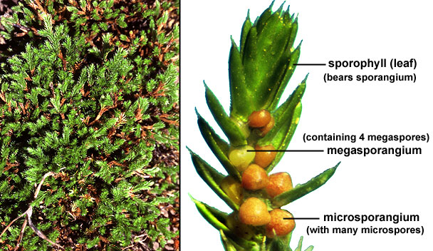

Slide 22
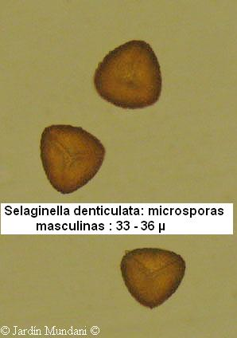
Spores

Slide 23
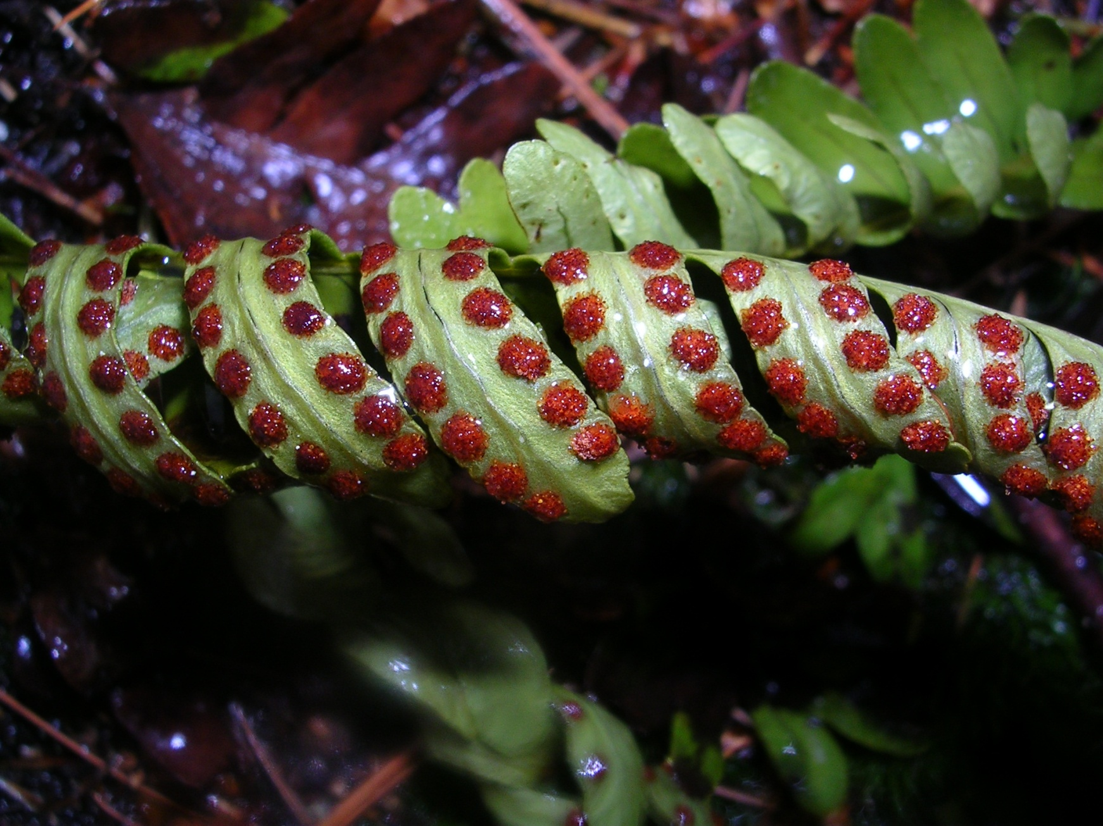

Slide 24
9. The sporophylls may be widely scattered on a plant (e.g., ferns) or may be clustered in definite areas and structures called cones or strobili (Selaginella, Equisetum).

Slide 25
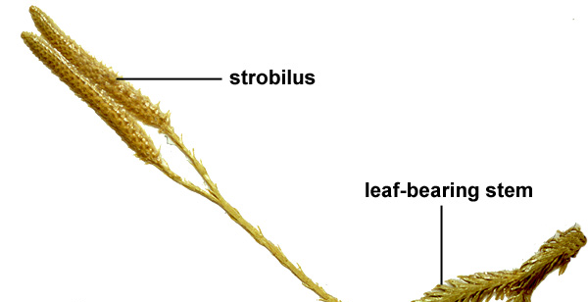
Strobilus

Slide 26
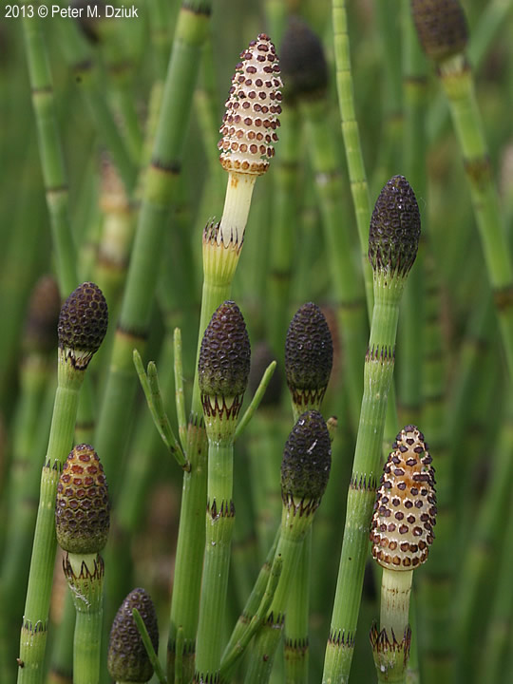

Slide 27
10. In certain pteridophytes the sporangia are produced within specialized structure, the sporocarps (e.g., Marsilea, Salvinia, and Azolla).

Slide 28
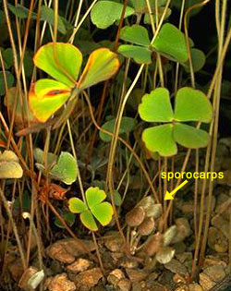
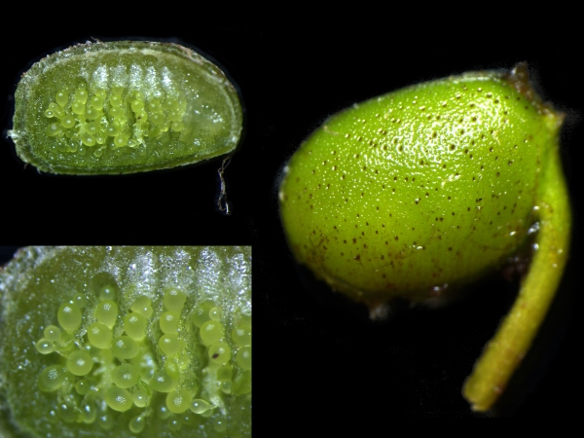
Marsilea sporocarp

Slide 29
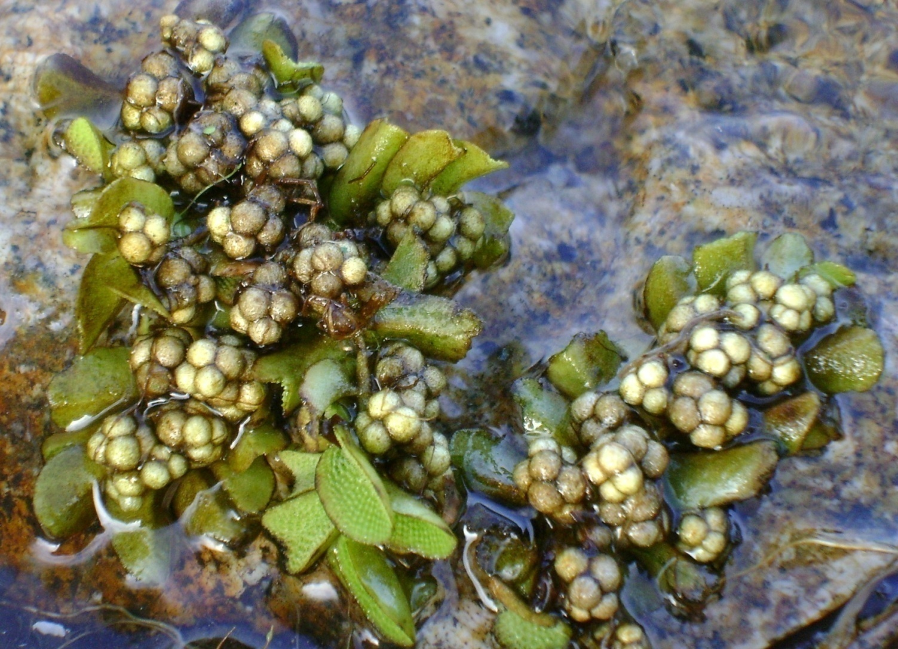
Salvinia sporocarp

Slide 30
12. The sporophyte plant may be homosporous (e.g., Lycopodium, Dryopteris) or heterosporous (e.g., Selaginella, Isoetes, Marsilea)

Slide 31
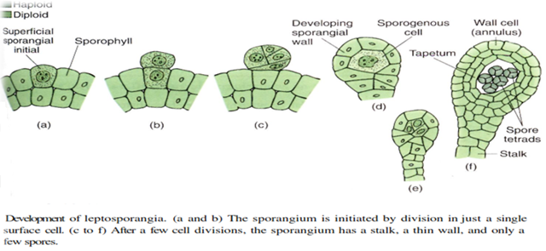
Leptosporangia

Slide 32
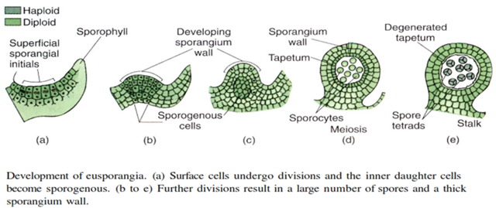
Eusporangia

Slide 33
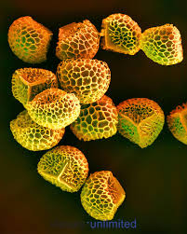
Lycopodium- homospore

Slide 34
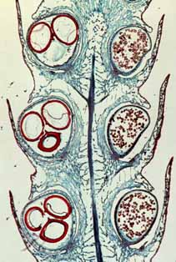
Heterospore

Slide 35
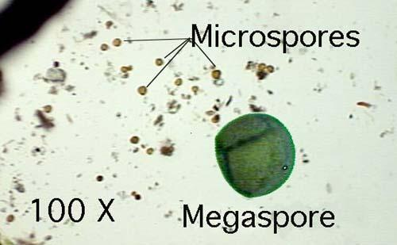
Selaginella- heterospore

Slide 36
The gametophyte
13. The spores on germination give rise to the haploid gametophytes or prothalli which are small and inconspicuous. The gametophytes in some pteridophytes are subterranean and in others they are retained within the resistant wall of the spore.

Slide 37
It is notable that wherever the gametophyte is retained within the spore the spores are of different sizes (heterosporous). The larger megaspores give rise to female prothalli which bear only archegonia, and the smaller microspores giving rise to male prothalli which bear only antheridia

Slide 38
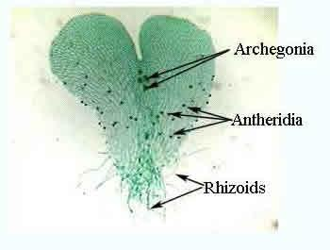

Slide 39
14. The gametophyte or prothallus bears the sex organs, antheridia and archegonia. Normally, the gametophytes formed from the homospores are monoecious, that is both antheridia and archegonia are borne on the same gametophyte or prothallus. The gametophytes formed from the heterospores are dioecious, e.g., the antheridia and archegonia develop in separate male and female gametophytes.

Slide 40
The antheridia
15. The antheridia may be embedded in the gametophyte or they may project from it. The embedded antheridia are commonly found in eusporangiate pteridophytes while the projecting ones are usually found in the leptosporangiate ferns.

Slide 41
The mature antheridium is globular and consists of an outer sterile wall inside which are found a large number of androcytes. Each androcyte metamorphoses into a single motile antherozoid.

Slide 42
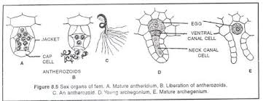

Slide 43
The archegonia
16. The archegonia are flask-shaped. Each archegonium consists of a basal swollen, embedded portion the venter and a short neck. The venter encloses the egg and ventral canal cell.
At maturity the apical cells of archegonium separate, the neck canal cells disintegrate forming a passage for antherozoids to reach the egg.

Slide 44
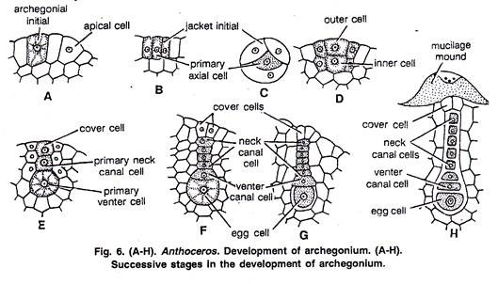

Slide 45
Fertilization
17. In all cases the fertilization is accomplished by the agency of water. With the result of the fusion of male gamete and female egg a diploid zygote (2n) is formed.

Slide 46
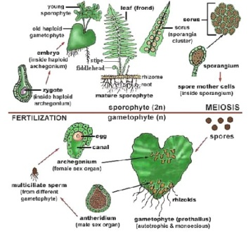

Slide 47
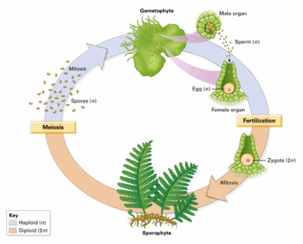

Slide 48
The embryo (The young sporophyte
18. The zygote undergoes repeated divisions to form a new sporophyte. The young sporophyte remains attached to the gametophyte by means of a foot and draws nourishment from the prothallus until it develops its own stem, roots and leaves. The sporophyte is dependent on the gametophyte only during its early stages.

Slide 49
THANK you

