Slide 1
Dr. UMA JAISWAL
Bhawans Mehta Mahavidyalaya
Bharwari, Kaushambi (U.P.)

Slide 2
Department of Zoology
Faculty of Science

Slide 3
B.Sc-III Paper - Ist
Applied and Economic Zoology
Unit Ist - Parasitology

Slide 4
Waucheria bancrofti - Nematode Parasite.
This is commonly known as filaria worm and causes elephantiasis.
It requires an intermediate culex female host as carrier of the disease

Slide 5
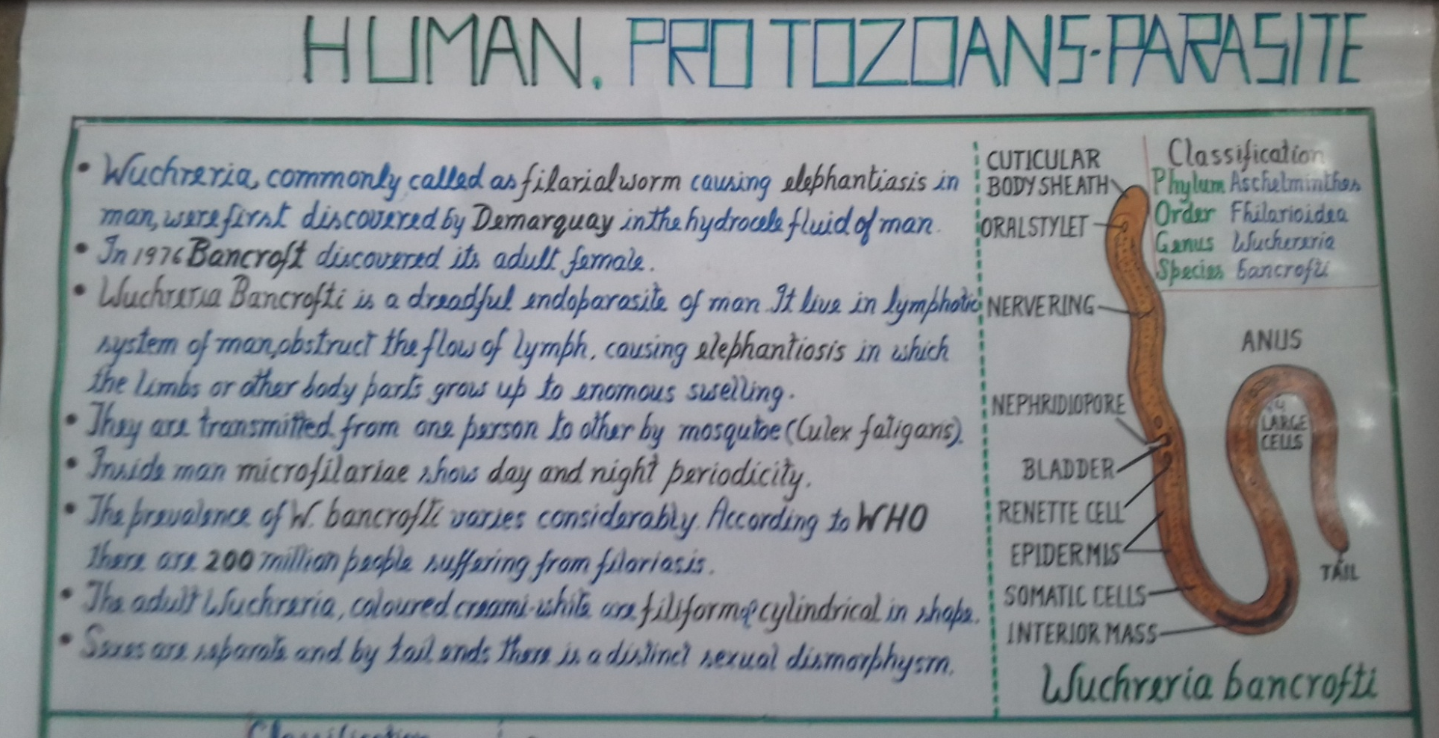

Slide 6
Trypanosoma Gambiense- Protozoan Parasite
T.gambiense is most notorious for causing African sleeping sickness.
This is carried by Tse-Tse fly glossina palpalis

Slide 7
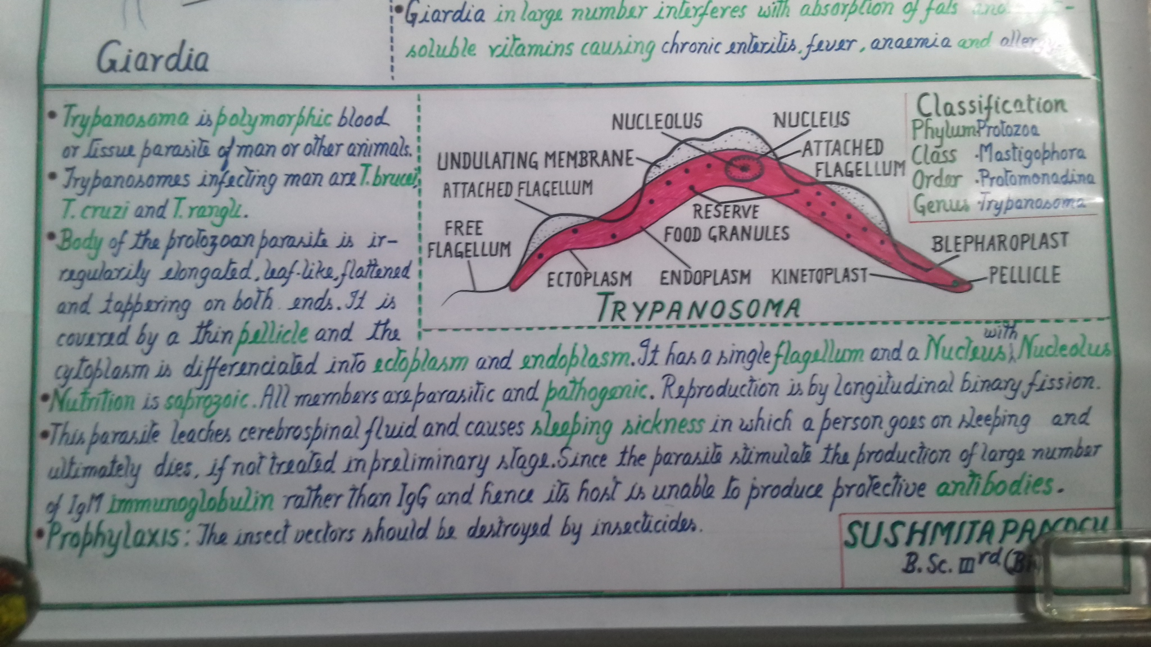

Slide 8
Giardia - Protozoan Parasite
It causes gastrointestinal disorder
They are transferred from one to another host by unhygienic condition.

Slide 9
