Slide 1
Demand Analysis
BY DR. SHWETA

Slide 2
Definitions of Demand
  According to Veera Anstey, “The demand for particular good is the amount that will be purchased at a given price and at a given time.”
  According to Benhaur, “The demand for anything , at a given price , is the amount of it which will be bought per unit of time at that price. ”
  In the worlds of Edword, “Demand is defined as the amount of commodity or service bought per unit of time at a given price

Slide 3
There are seven essentials of demand which are as follows :
1. Desire for a commodity.
2. Capacity to pay for it.
3. Willingness to pay for it.
4. Quantity bought and sold.
5. At a given price.
6. At a given time, it may be a day, a week or a month.
7. At a given place.

Slide 4
Demand analysis is essential for a business firm in the following ways :
1. Demand analysis is required to identify and measure the forces that determine sales.
2. Extent of production and cost allocation depend upon demand analysis.
3. Demand analysis is essential for pricing and inventory holdings.
4. Demand analysis helps in sales forecasting and profit planning.
5. New product policy and advertisement policy cannot be drawn without the analysis of demand.

Slide 5
6. Research and development strategy cannot be framed without demand analysis.
7. Demand analysis is the basis of tracing the trend of firm’s competitive position in the market.

Slide 6
Types of Demand
For a powerful demand analysis for managerial decisions, it is necessary to classify the large number of goods and service available in every economy.

Slide 7
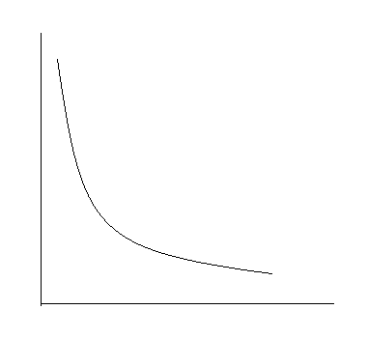
Main types of demand are as under :
1. Price Demand :
Price demand expresses the relationship between the price and demand of commodity , other things being equal.
D_{x} = f(P_{x})
Y
D
PRICE
D
O
DEMAND
X

Slide 8
2. Income Demand :
Income demand expresses the relationship between income of the consumer and quantity demanded of a commodity , other things remaining the same.

Slide 9
3. Cross Demand :
Cross demand expresses the relationship between the quantity demanded of good ‘x’ and the price of related good ‘y’, other things remaining the same.
D_{X} = f(P_{y})

Slide 10
4. Joint or Complementary Demand :
When to satisfy a particular want , two or more than two goods are demanded simultaneously , then such a demand is called joint demand.

Slide 11
5. Composite Demand :
Composite demand refers to the demand for one commodity in order to satisfy two or more wants.

Slide 12
6. Direct and Derived Demand :
When a commodity is demanded for the direct consumption, it is called direct demand.
Derived demand refers to the demand for one commodity as a result of demand for another.

Slide 13
7. Competitive Demand :
Demand for substitutes is known as competitive demand . Substitutes are those goods which can be used for one another.

Slide 14
8. Consumers’ Goods and Producers’ Goods Demands :
Consumers goods are goods used for final consumption, e.g. food items , readymade clothes, houses.
Producers’ goods are used for production of other goods, such as machines , tools, raw-materials.

Slide 15
Perishable and Durable Goods’ Demand :
9.
Both consumers’ and producers’ goods are further divided into perishable and durable goods . Perishable goods are those which can be consumed only once, while durable goods are those which can be used more than once over a period of time.

